Slide 1
Quality Assurance
“Were you listening to The Dude's story, Donny?”

Slide 2
Joel Spoelsky, Leaky Abstractions
“All non-trivial abstractions, to some degree, are leaky.“
(All software has bugs.)
http://www.joelonsoftware.com/articles/LeakyAbstractions.html

Slide 3
Hurray! I’m employable.

Slide 4
John Maynard Keynes:
“There is no harm in being sometimes wrong - especially if one is promptly found out.”
In fact, making buggy software can be great!..
...As long as we find and fix the bugs quickly.

Slide 5
Finding a bug while elbow deep in the code
=
Easy to fix!

Slide 6
Receiving a bug after a few days… =
Transient memory loss. (read: being human)
Others’ve begun adding to the buggy code.
Difficult to trace the origin.
Oh good, let me just switch branches agai…

Slide 7
Speed is Critical.

Slide 8
Why does Quality Matter?
I know there's really nobody to blame for this but myself, well, I don't know, maybe the Buffalo Bills, the Boston Red Sox, or Mr. T or, or the Jets…
Wait a minute, Mr T.? Are you telling me that you bet on the fight in Rocky III, and that you bet against Rocky?
Hindsight is twenty-twenty, my friend.

Slide 9
Case Study: Microsoft
Back in 2008 Microsoft buys Danger Inc for a rumored half a Billion.
In 2009 they migrated user data to the Azure cloud.

Slide 10
Case Study: Microsoft
Cue… Catastrophic Data loss!
And, a Class action lawsuit against Microsoft!
And, a loss of confidence in the Azure Cloud!
And, the immediate tank of their then launching product the “Kin”!

Slide 11
Case Study: Microsoft
In less cataclysmic terms,
the effects of Quality are:
Easier bug fixes.
Better customer experience.
Faster development.
(Really? Yes, really.)

Slide 12
How to measure Quality: by numbers
When I was a little kid my mother told me not to stare into the sun, so once when I was six, I did.

Slide 13
Measurement
So, how do you measure Quality?
How do you measure a good, QA Engineer?

Slide 14
By Number (of Bugs)
Quality Metric:
May reward under-reporting of issues.
Or, worse, devs might stop taking chances.
QA Engineer Metric:
Rewards over-reporting of minor or inconsequential issues.

Slide 15
Measurement
:(

Slide 16
By Severity
Quality Metric:
Can reward lying / overemphasizing severity.
May punish devs who work on difficult projects.
QA Engineer Metric:
Rewards QA paired with bad devs.

Slide 17
Measurement
:(

Slide 18
By Provenance
If ugly bugs slip through to production, then tracing how they got there is important.
Is it our first time seeing it?
How long was it there?
Can we catch it next time?

Slide 19
Measurement
:D

Slide 20
By Number of Broken Builds
Are you failing to run automation tests before checking into the repository?
Jerk.
Negative a billion points!

Slide 21
By Number of Broken Builds
Also a measure of good White Box QA :D
Do Devs use your tests?
No? They’re your customers.
You need to assess and approach differently.

Slide 22
By Coverage
By number of unit tests, or integration tests.
Some features aren’t worth covering*, so unadulterated coverage stats can be misleading.
*Some tests require a TON of effort to implement. Not worthwhile.

Slide 23
Measurement
There are many stats that can speak to “Quality”.
At the end of the day Devs trade Size, Maintainability, Reliability, Efficiency, and a lot of other Adjectives for ...

Slide 24
Measurement
Speed!
(and happy Product Groups)

Slide 25
Measurement
Which is to say:
Stats are only meaningful with context.
(Caveat Emptor!)

Slide 26
Measurement
Get context in Retrospectives.

Slide 27
Testing Strategies
Science isn't about why, it's about why not. You ask: why is so much of our science dangerous? I say: why not marry safe science if you love it so much.

Slide 28
Boundary Testing
Edge Cases!
(Occasionally useful?)
Good for new models, new DB tables, etc.
(check constraints)

Slide 29
Dog Fooding
Company makes Product.
Company uses own Product.
Result:
Common Areas get tested well.

Slide 30
Regression Testing
Everytime you see a bug, add to test suite.
Result:
Tricky Areas are tested well.

Slide 31
Model Checking
Mathematical / Algorithmic proof of correctness.
Almost never happens in reality.
User Interactions muddy things.

Slide 32
Exploratory Testing
Just play with it.
Reveals hidden cases that may be difficult to uncover from the proverbial “arm chair”.
QA can be boring.
Have fun!

Slide 33
Fuzz Testing
Bombard inputs with random or semi-random data.
Inadvertently, does Boundary Testing.
Yay, stochasticity!

Slide 34
Functional Testing
Test one feature of the product, in isolation.
Once a bug is found, you likely know what code caused it.

Slide 35
Integration Testing
Opposite of Functional. Lump it all together.
a² + b² = c²
Even better, a² + b² + c² = z²
The more interactions at play, the better.

Slide 36
Team Testing
Just need another person + 5 minutes.
First, you run through the Happy Path + name known issues.
Then, other(s) discover negative cases.
Everyone wins!

Slide 37
Team Testing
Half of QA is getting a fresh set of eyes.
We all have eyes!* Offer to QA someone’s feature, if they can QA yours.
*(Unless you’re blind, in which case as part of the American’s with Disabilities Act I’m required to apologize to you. I sorry.)

Slide 38
Testing the Razor’s Edge
Query DB and logs for anomalous stats or impossible states.
Facebook does this for Performance Testing.
Deal with the craziest cases first. Difficult fixes will often resolve simpler cases for free.

Slide 39
Tools of the Trade
Look, Sammy, I'm not a very good shot…
But, the Samaritan here uses REALLY big bullets.

Slide 40
Manual Tools
Most manual processes can be automated.
So, let’s cover manual first.

Slide 41
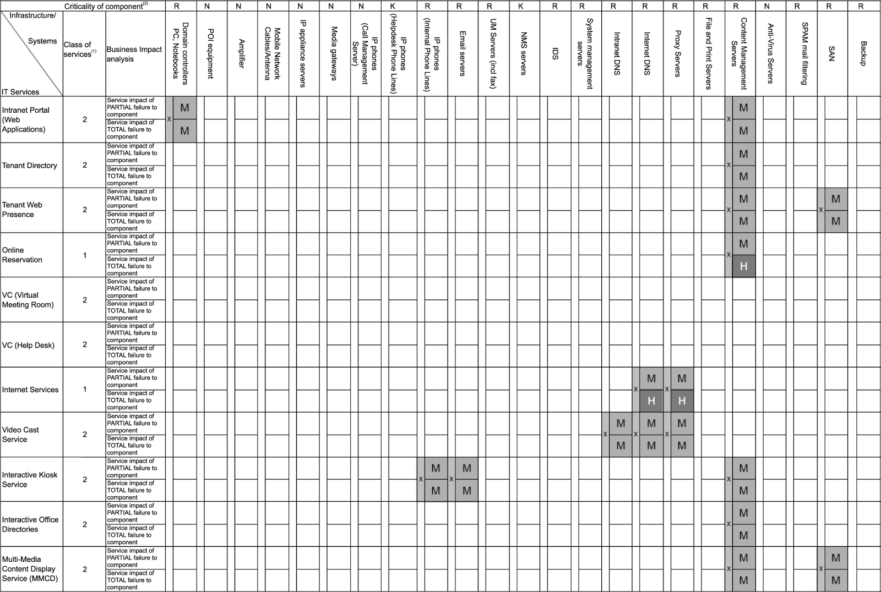
QA Matrix

Slide 42
QA Matrix
Great for organization.
Fails to capture complex interactions.
Only allows two items (2-axis) to interact.

Slide 43
QA Dimensions
Allows tests spanning more than two domains.
Pick one or more of each:
Browser: FF, IE, Chrome
Cookies: On, Off
Javascript: On, Off
Interactions: click, middle click, right click, back, refresh, hard refresh
Connectivity: Poor connection, session expiry, good connection, insanely fast connection, Local caching

Slide 44
QA Dimensions
Allows tests spanning more than two domains.
Pick one or more of each:
Browser: FF, IE, Chrome
Cookies: On, Off
Javascript: On, Off
Interactions: click, middle click, right click, back, refresh, hard refresh
Connectivity: Poor connection, session expiry, good connection, insanely fast connection, Local caching

Slide 45
QA Dimensions
The green is one path.
There are many more permutations.
QA Dimensions are hard to communicate with a team, but essential for ensuring full coverage.

Slide 46
Test Plan
Great if your company plays the blame game.
At it’s most formal denotes Test Coverage, Methodology, and Responsibility.
Informally, just helpful for devs pre-code: “I’ll try to break the thing, like this.”

Slide 47
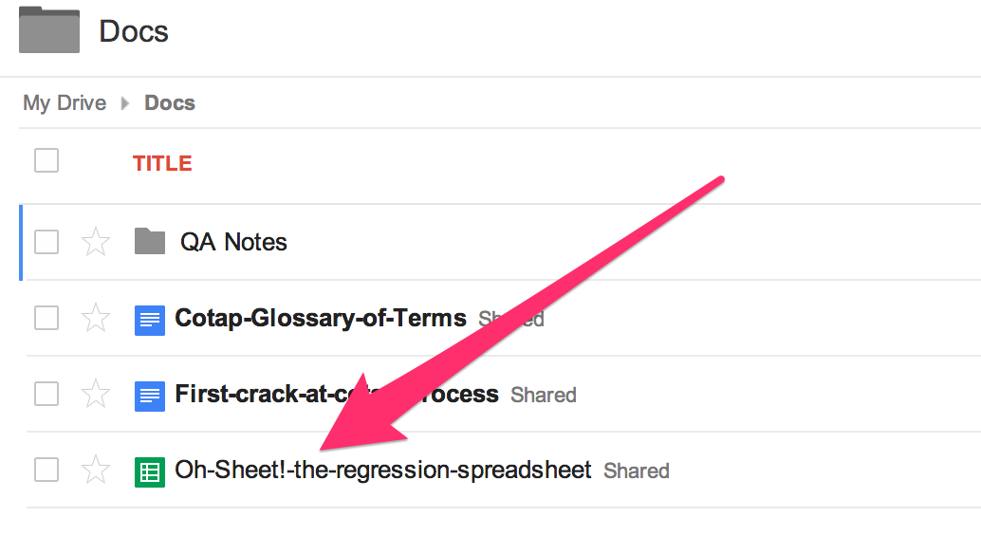
Regression Test Document

Slide 48
Regression Test Document
A natural repository for product behavior.
Constantly being tested!
Consequently, it’s up to date.

Slide 49
Server Logs
Find Error.
Does it already exist in Bug Tracking? No?
Log Error. Easy!

Slide 50
Customer Feedback
Customers report bugs, too.
It shouldn’t happen, but it does.

Slide 51
Automation Tools
Fuzz Testing
Integration Testing ⚠ Fragile
Functional Testing
Unit Testing
Lint Checker

Slide 52
How the Leaders Do It
Listen, strange women lyin' in ponds distributin' swords is no basis for a system of government.
Supreme executive power derives from a mandate from the masses, not from some farcical aquatic ceremony.

Slide 53
The big guys do without QA, right?
Nope.
All companies invest in Quality.
So, All companies hire people to do QA.
QED. Whether they call them QA or not, someone there is maintaining Quality.

Slide 54
Case study: Box.net
Claim they do not employ QA Engineers.
Have a Tools and Frameworks division.
Members are experienced software engineers. They provide testing tools, process, CI, code review, etc.
Box also employs “Code Reliability Engineers”. (CRE)

Slide 55
Case study: Box.net
Hey… Wait a minute…
Those CREs sound like...

Slide 56
Case study: Box.net
CREs create and tool a large set of automated tests. (Devs also contribute to tests)
Helps catch bugs fast! (SPEED is king!)
Before big changes make it to Production, a third party organization performs black box testing.

Slide 57
Case study: Box.net
AppLause is one such Third Party.
We start with them next week!
(Box and Google also use them)

Slide 58
Case study: Box.net
What is Black Box testing?
Blackbox = Manual testing.
Whitebox = Automation testing.
More specifically, the ability to read, write, and review code.

Slide 59
Case study: Box.net
Whitebox is sometimes called “QE” or “SDET”.
(Quality Engineering or Software Development Engineering in Test)
Companies go to great lengths to distance themselves from the term “Quality Assurance”.

Slide 60
Moving On
I gotta say, Whitebox is sounding way better...
So, what IS the use of Blackbox?

Slide 61
Consider the Chinese Room:
http://en.wikipedia.org/wiki/Chinese_room
Searle writes in his first description of the argument:

Slide 62
"Suppose that I'm locked in a room and ... that I know no Chinese, either written or spoken".
He further supposes that he has a set of rules in English that "enable me to correlate one set of formal symbols with another set of formal symbols", that is, the Chinese characters.
These rules allow him to respond, in written Chinese, to questions, also written in Chinese, in such a way that the posers of the questions – who do understand Chinese – are convinced that Searle can actually understand the Chinese conversation too, even though he cannot.

Slide 63
White Box
Understanding how the room works promotes one type of testing.
Are the translation rules accurate?
Does it account for all Chinese dialects?

Slide 64
Black Box
Ignorance of the rules, paradoxically, promotes another line of thought.
What happens when Mr. Searle runs out of cards to write on?
What happens if slang or misappropriated english phrases are mixed in?

Slide 65
What makes a good QA Engineer?
Attention to detail.
Good communication.
Good personality. (read: NOT “your code sucks, dude”)
Good understanding of ______ technology. (Web, mobile, etc)
Quickly gets up to speed when confronted with new challenges and opportunities to learn.

Slide 66
What makes a good QA Engineer?
Sounds a lot like a Developer.
The ideal QA is a Developer.
But, Developers are expensive.

Slide 67
Hurray! I’m employable.

Slide 68
In Summary
So long, and thanks for all the fish.

Slide 69
In Summary
Quality is higher when Developers own it.
But, writing a test is expensive (time-wise).
And, dev time is expensive (money-wise).

Slide 70
In Summary
So, people are employed (don’t call them QA!)
to empower devs via automation tests.
Blackbox QA tends to get outsourced.
(for now!)

Slide 71
fin

